Slide 1
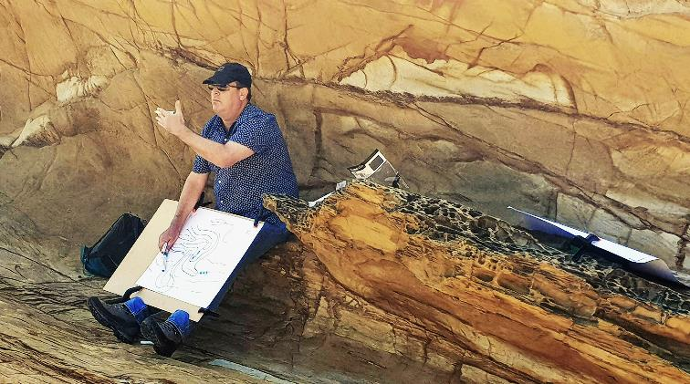













Where it all started…

Slide 2
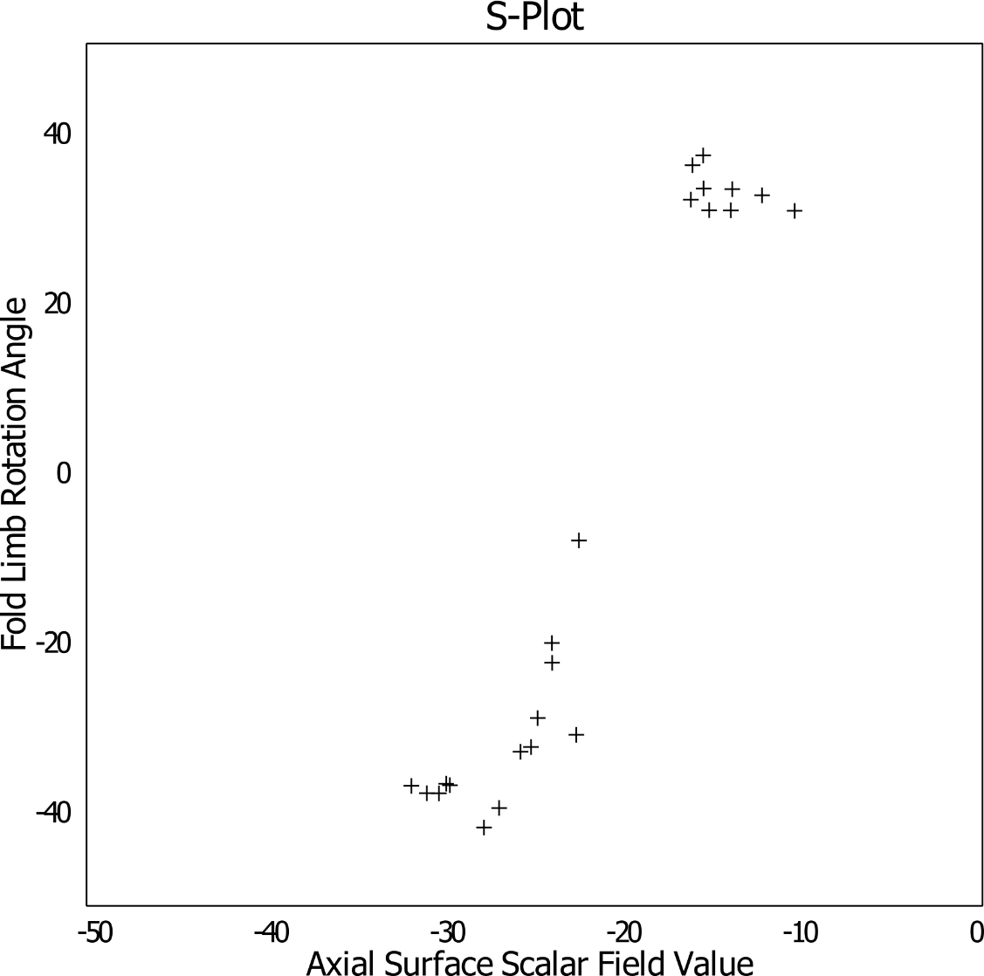
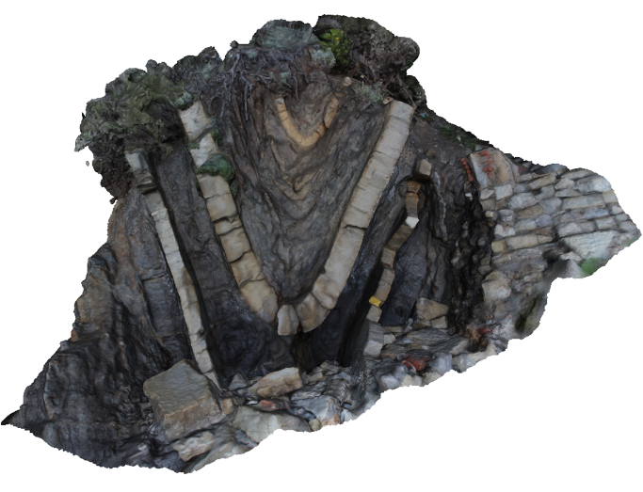
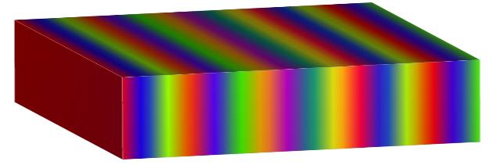
Fold structural frame
Point of inflection?
Hinge
Axial Surface Scalar field value
Limb
Point of inflection?
½ Wavelength

Slide 3
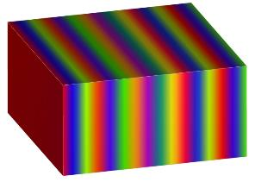
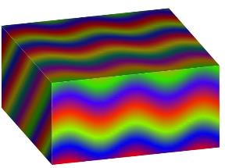
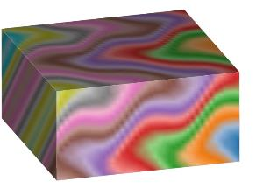
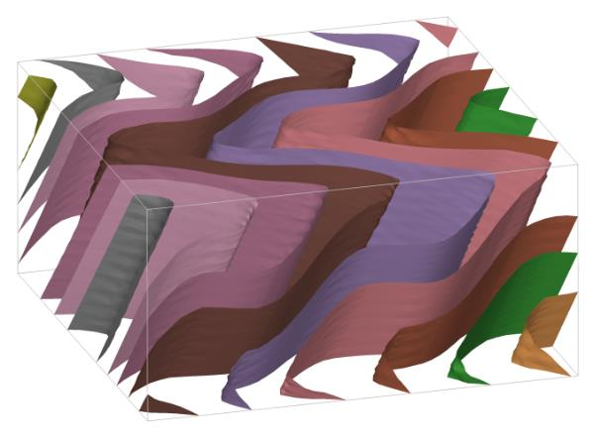
Time-aware Geometrical modelling – combining structural frames
Poly-deformation:
Modelling events step by step
Time-aware process: youngest event is modelled first, then the second youngest, etc… until the primary foliation (most often bedding) is modelled
Modelling is geometry based (not mechanical)
Event types:
each fault or family of faults
Folding event
Unconformity
Intrusions
S2⁺
S2
S1⁺
F2
S1⁺
S1
S0⁺
F1
S0⁺
S0
Laurent et al., 2016, EPSL

Slide 4
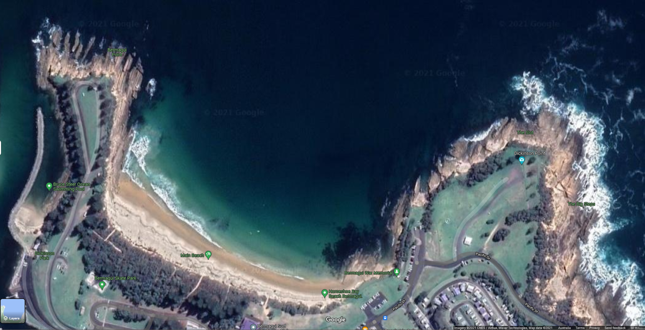
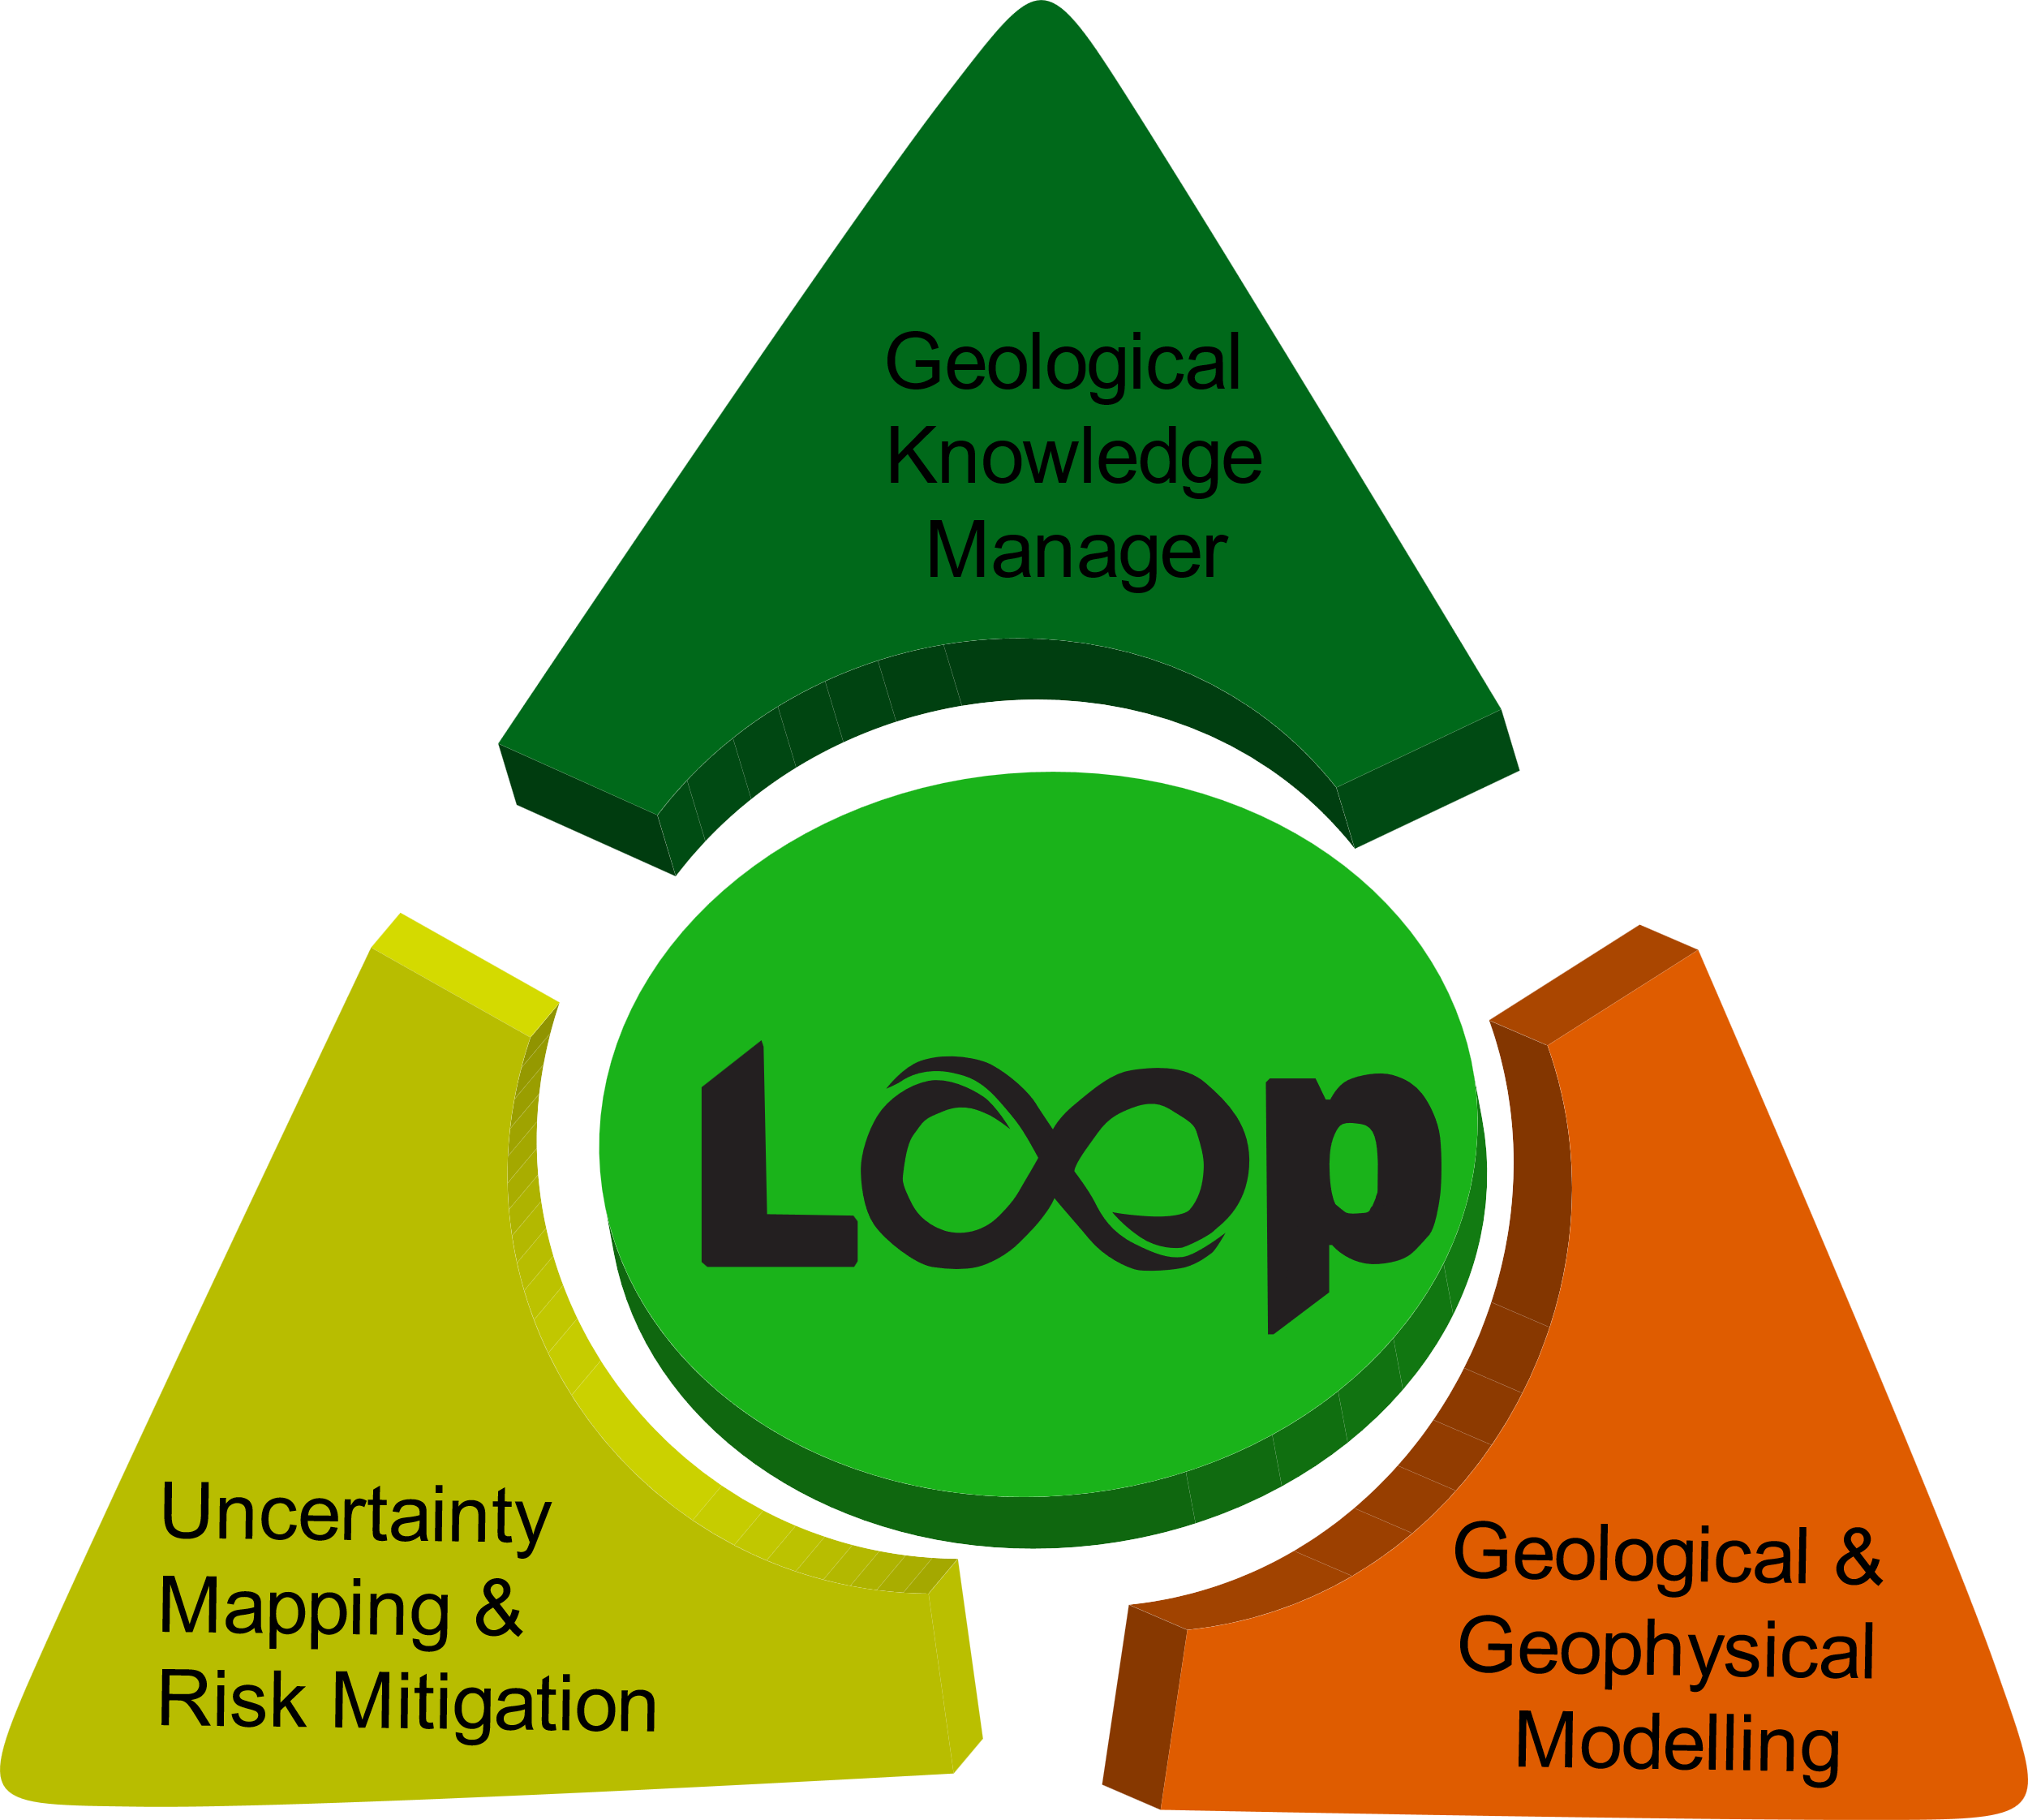
Title

Slide 5
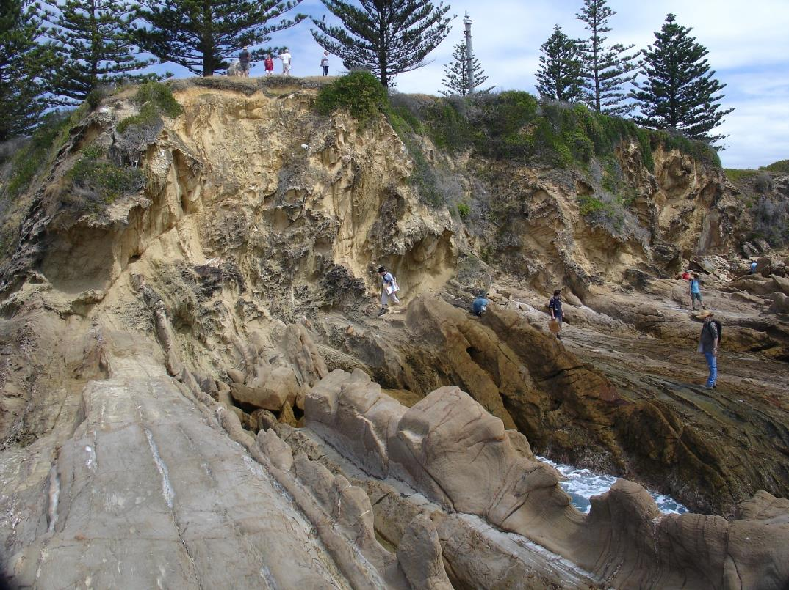
A time aware interpolator for foliations and structural information
Quantitative Modelling of Geological Structures
Looking South into Bermagui Heads, stratigraphy dipping steeply West
Next slide detail

Slide 6
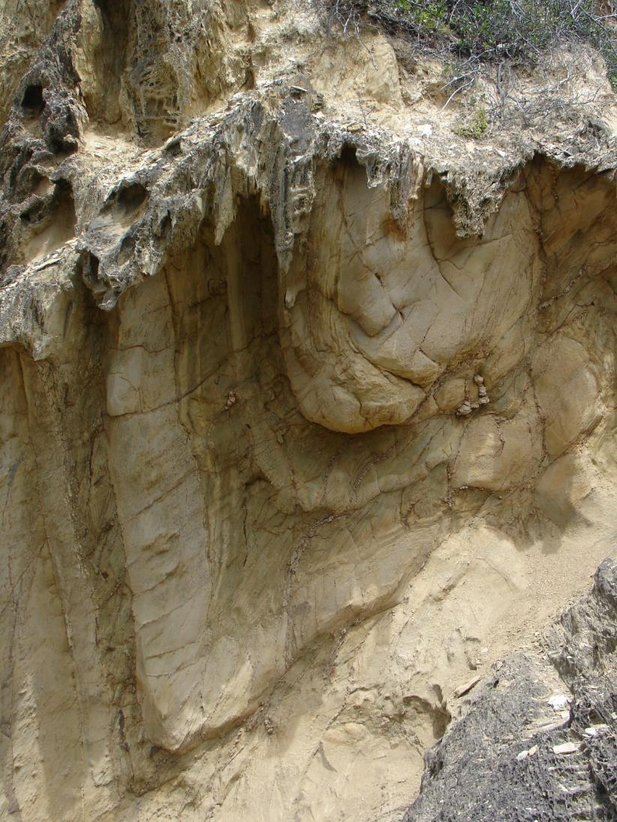
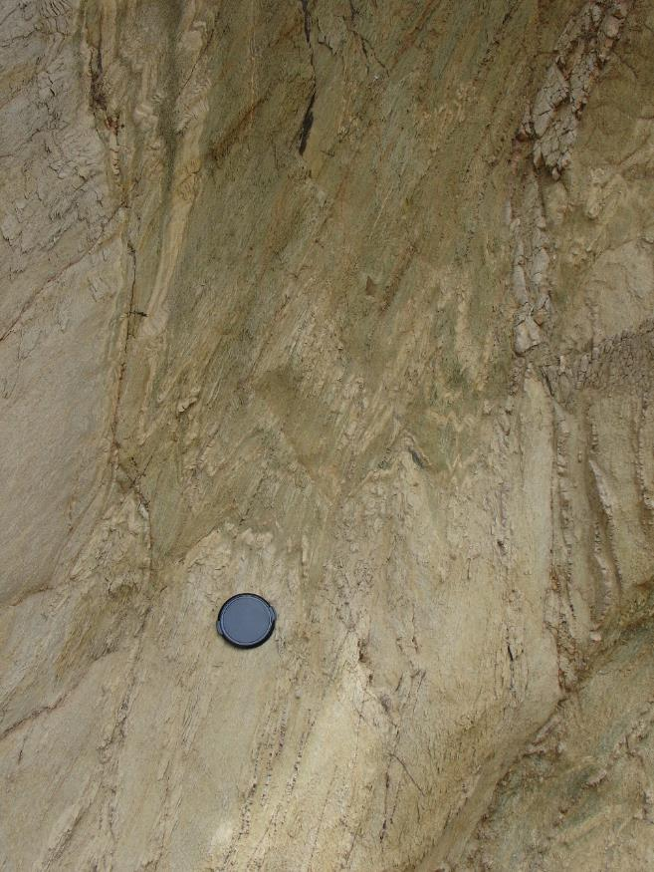

Slide 7
Topography

Slide 8
Topography

Slide 9
Title

Slide 10
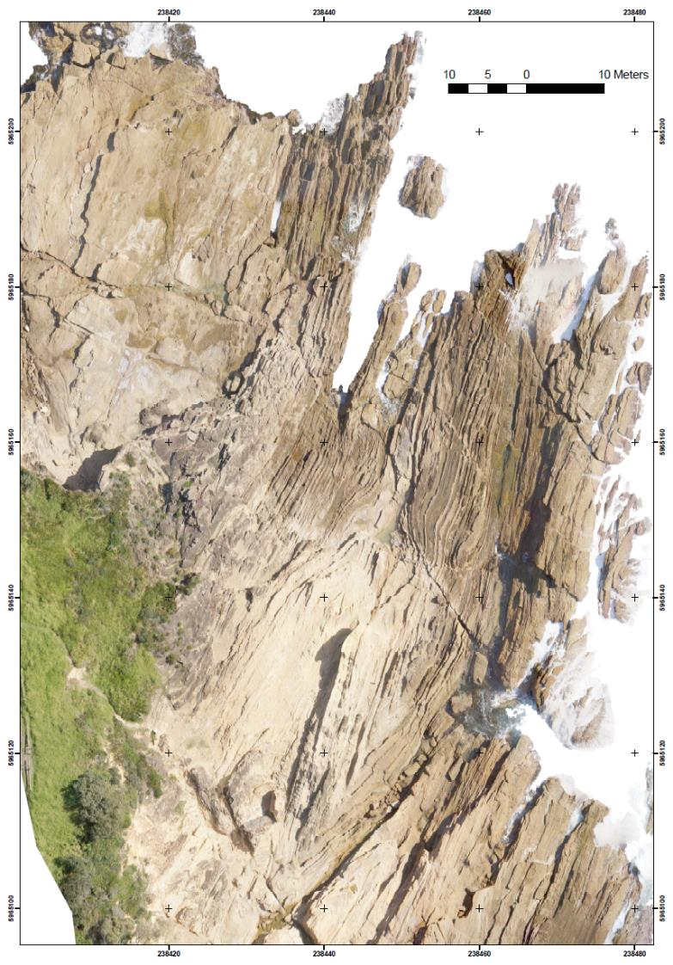

Title
5
4

Slide 11
Title
5
3
3
4

Slide 12
Title
2
5
3
3
4
2

Slide 13
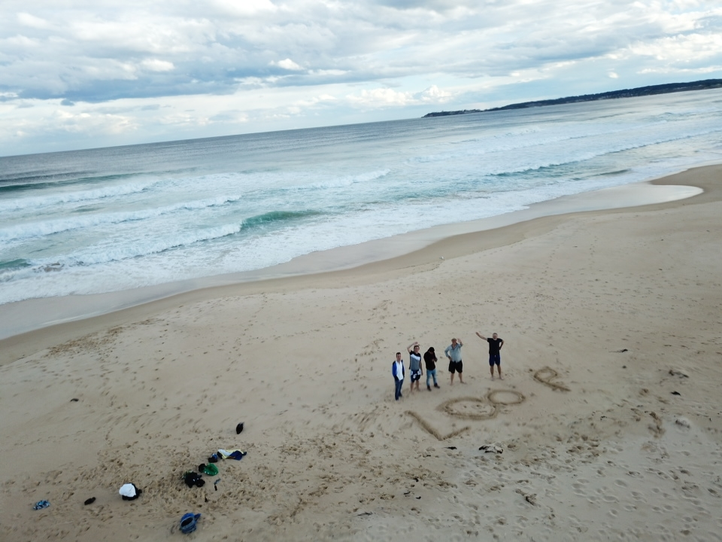

Slide 14














Loopers? Who are we?

Slide 15
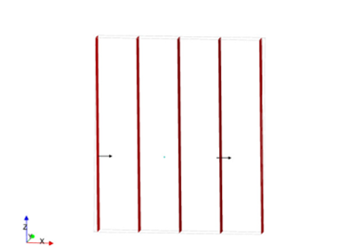
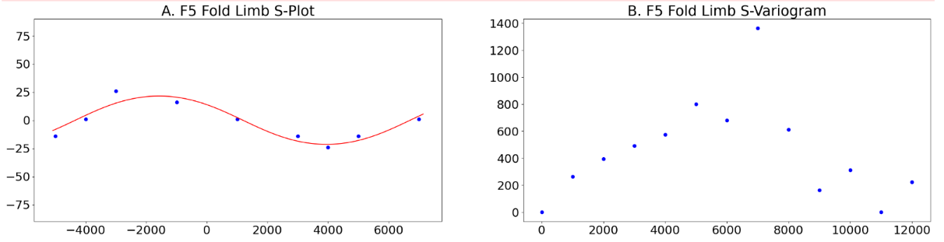
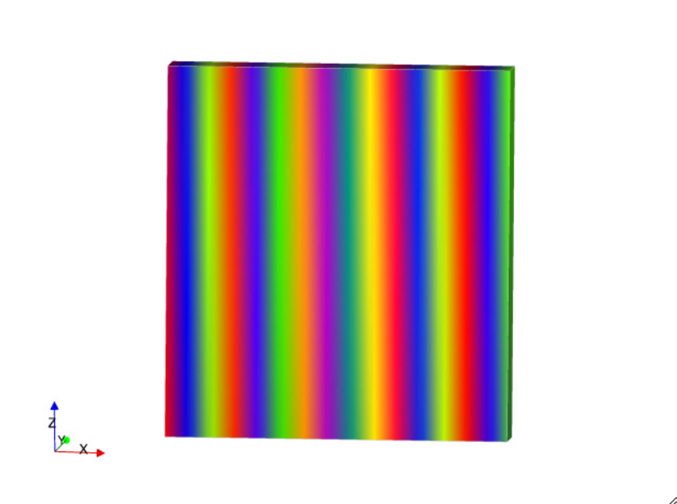
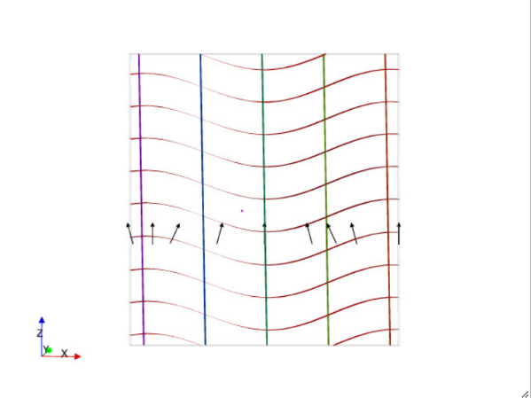
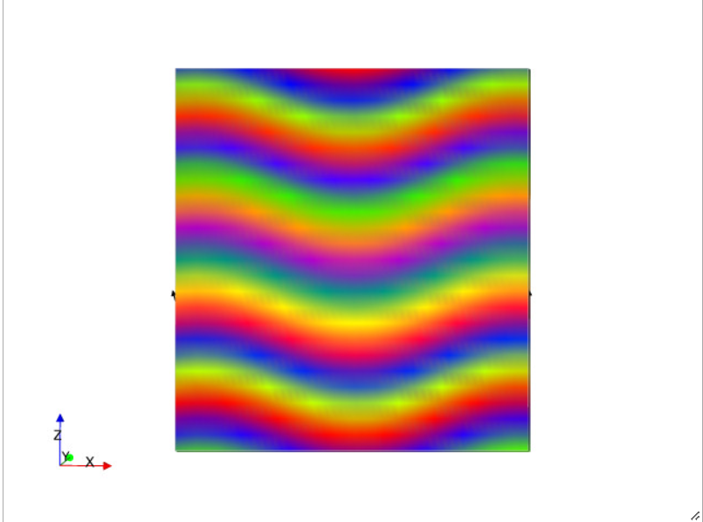
Modelling S5 and S4
Rotation angles (measurements of S4) of S4 around F5 (all blue dots)
Normals to S5
Fitted Fourier series w/ wl from s-variogram
S5 scalar field
Modelled S4 scalar field
Normals to S4
(arrows)
S5 iso-surfaces

Slide 16
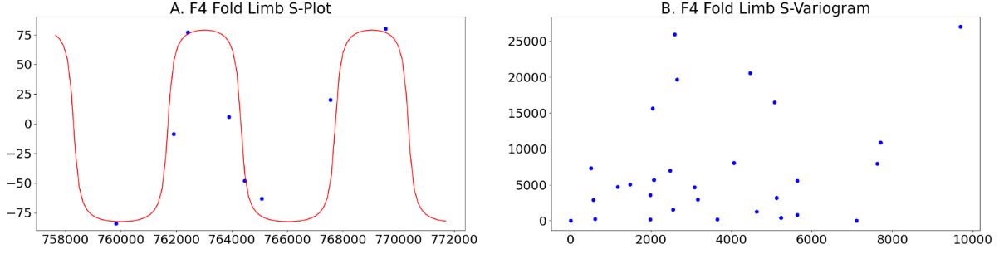
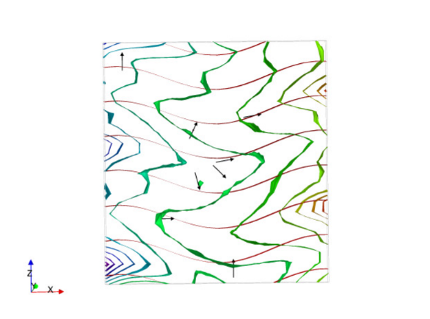
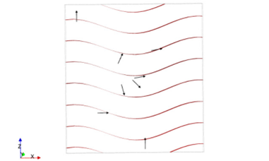
Modelling S3 in F4 fold frame
Rotation angles (measurements of S3) of S3 around F4 (all blue dots)
S4 scalar field
Fitting a Fourier series w/ wl from s-variogram
S4 and S3 iso-surfaces. S3 are in green
Normals to S3
Normals to S3
(arrows)

Slide 17
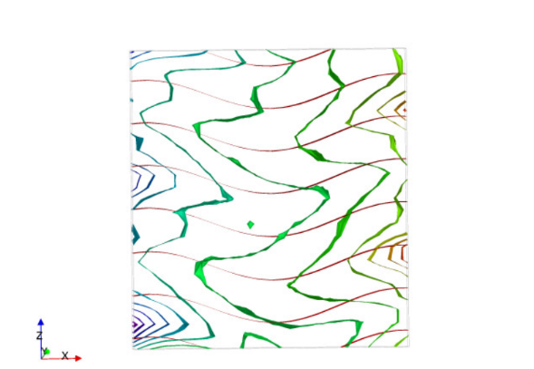
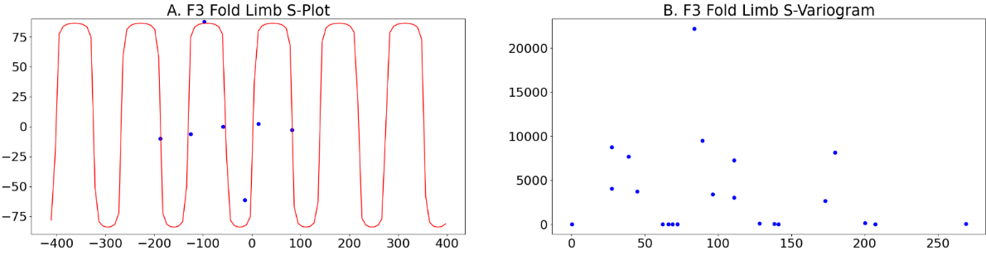
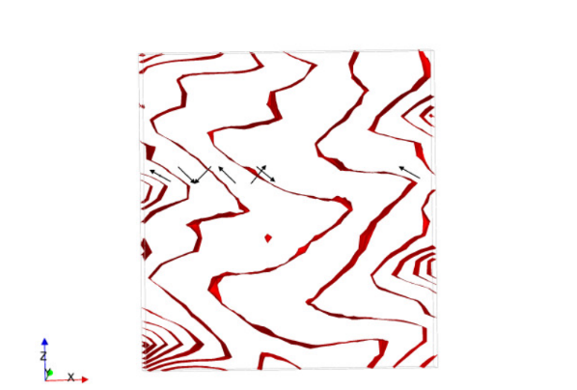
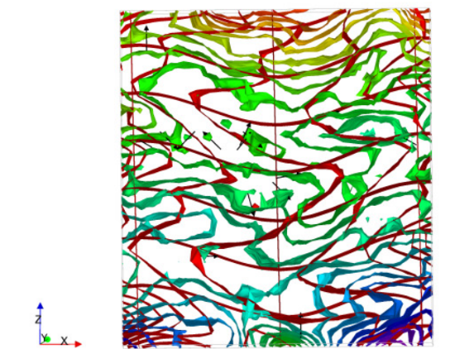
Modelling S3 in F4 fold frame
Rotation angles (measurements of S2) of S2 around F3 (all blue dots)
S3 scalar field
Hinge
Fitting a Fourier series w/ wl from s-variogram
S5, S4, S3 and S2 surface trends showing the expected trends.
Results are far from due to resolution issues and constraints inconsistencies.
Normals to S2

